Slide 1


PCI Big Beam Team
Natalie Noroian, Nicole Neilson, Jackie Crowley, Elena Mae Reyes

Slide 2


Project Purpose
  Create a precast/prestressed concrete beam
Client
  Precast/Prestressed Concrete Institute (PCI) Competition Judges
  PCI Producing Member, TPAC

Slide 3

Project Background
NAU capstone teams have participated in the PCI Big Beam Competition since 2013
Focus on improvement with schedule management / beam analysis / concrete analysis
Each beam design will be scored based on:
  Design Accuracy
  Cost
  Weight
  Deflection
  Accurate Predictions
  Report Quality
  Practicality, Innovation, & Conformance with Code
Figure 1: Image in PCI Big Beam Competition Rules [1]

Slide 4
Technical Considerations
Structural analysis
Concrete mix design analysis
Design techniques
Potential Challenges
Cost
Weight of Concrete
Time
Stakeholders
Dr. Tuchsherer
Tpac
PCI
Notes:
reinforcement is determined for a beam

Slide 5
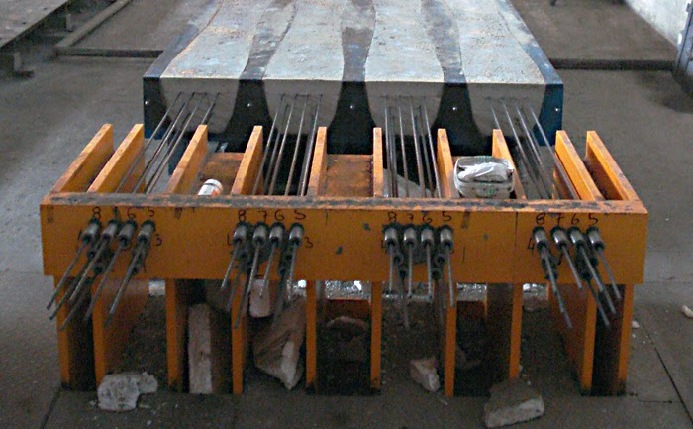
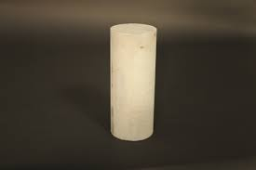
Project Scope
Figure 2: Method of pretensioning strands [2]
Task 1: Prestressed Design
Task 1.1: Introduction to Prestressed Design
Task 1.2: Analysis Methodology
Task 2: Concrete Mix Design Analysis
Task 2.1: Concrete Mix Research
Task 2.2: Concrete Mix Testing
Task 2.3: Selection of Concrete Mix
Figure 3: Typical cylinder used for testing [3]

Slide 6
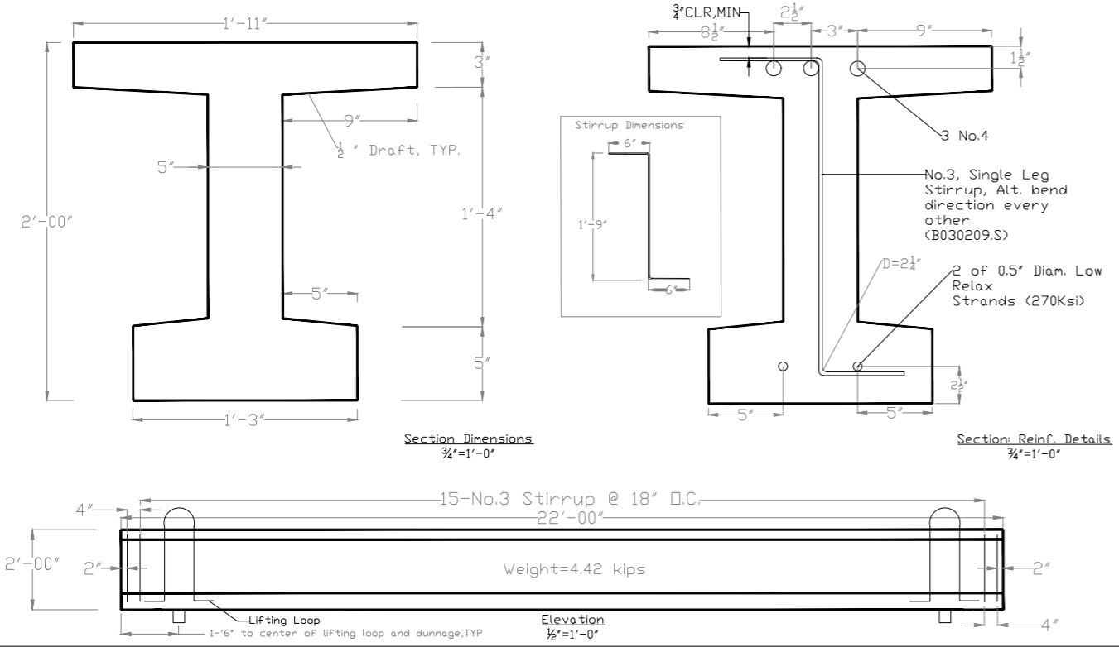
Task 3: Beam Design Structural Analysis
Task 3.1: Create Different Beam Designs
Task 3.1.1: Create Cross-Sections for the Beam
Task 3.1.1.1: Determine Reinforcement Configuration and Rebar Size
Task 3.1.1.2: Select Dimensions of the Beam
Task 3.1.2: Flexural Design
Task 3.1.3: Shear Design
Task 3.2: Final Beam Selection
Task 3.3: Refined Predictions
Task 4: Shop Drawings
Created using AutoCAD software
Sent to Tpac in mid-February, allowing time for revisions
Figure 4: The 2019-2020 NAU team AutoCAD drawings [4]

Slide 7
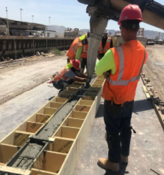
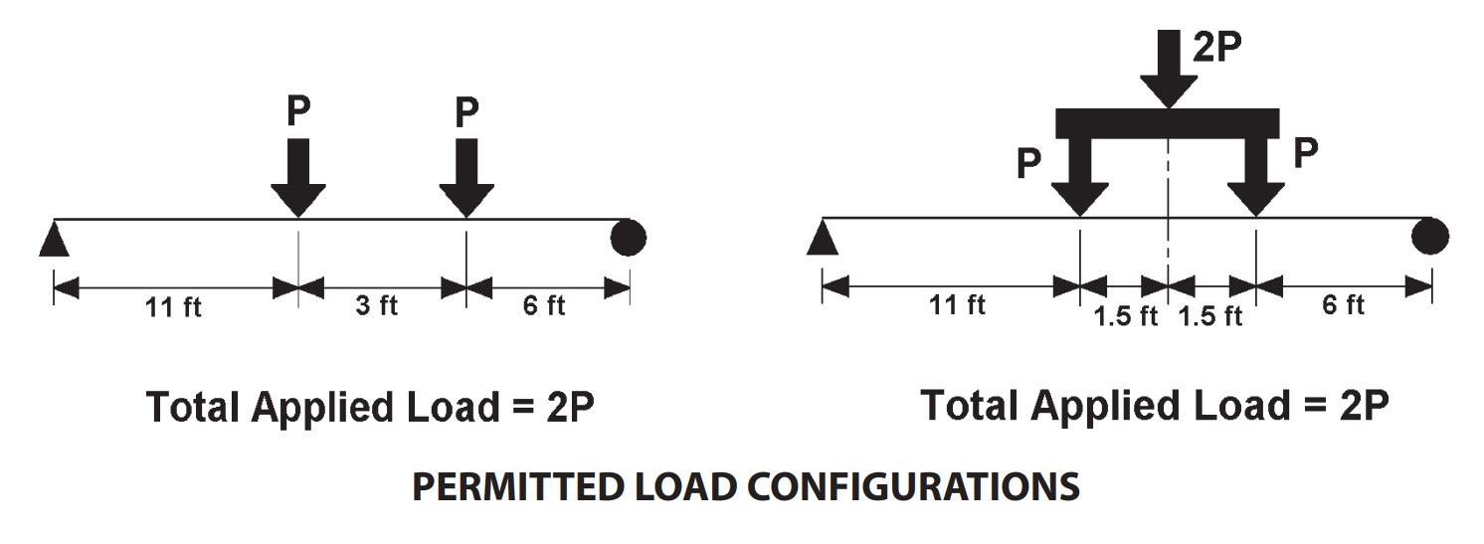
Task 5: Oversee Concrete Pour on Fabrication Day
Task 6: Testing the Beam
Task 6.1: Equipment Set-Up
Task 6.2: Final Predictions
Task 6.3: Load Beam Until Failure
Task 6.4: Measure the Beam Deflection
All stirrups and reinforcing will be checked, ensuring they match the shop drawings
Pour day will occur in mid-March
Figure 5: The 2017-2018 NAU team on pour day [5]
Figure 6: Loading configuration for beam test [1]

Slide 8
Task 7: Impacts
Task 7.1: Social Impacts
Task 8: Deliverables
Task 7.2: Environmental Impacts
Task 7.3: Economical Impacts
Task 8.1: 30% Submission Report & Presentation
Task 8.2: 60% Submission Report & Presentation
Task 8.3: 90% Submission Report & Presentation
Task 8.4: Video of Testing
Task 8.5: Website
Task 8.6: Final Report for CENE 486 and the PCI Big Beam Competition
Task 8.7: Final Presentation

Slide 9
Task 9: Project Management
Task 9.1: Meetings (Team, Client, TA, and GI)
Exclusions
Task 9.2: Schedule Management
Task 9.3: Resource Management
Task 9.4: Tpac Coordination
Task 9.4.1: Obtaining Concrete Mix Data
Task 9.4.2: Obtaining Test Cylinders
Task 9.4.3: Beam Fabrication/Team Travel to Tpac Location
Create Concrete Test Specimens
Beam Fabrication
Transporting the Beam/Test Cylinders to Flagstaff

Slide 10
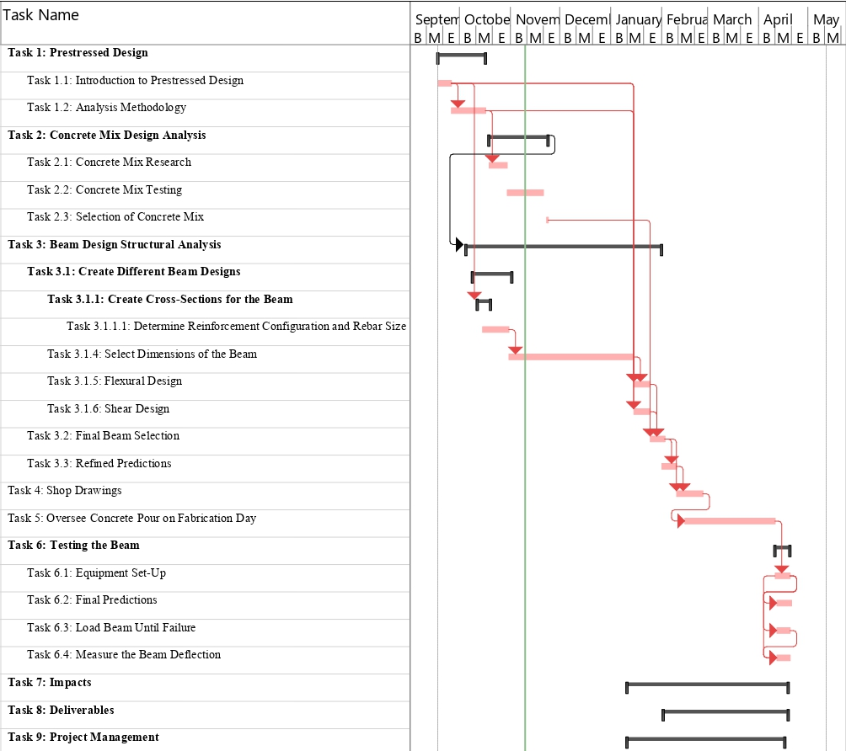
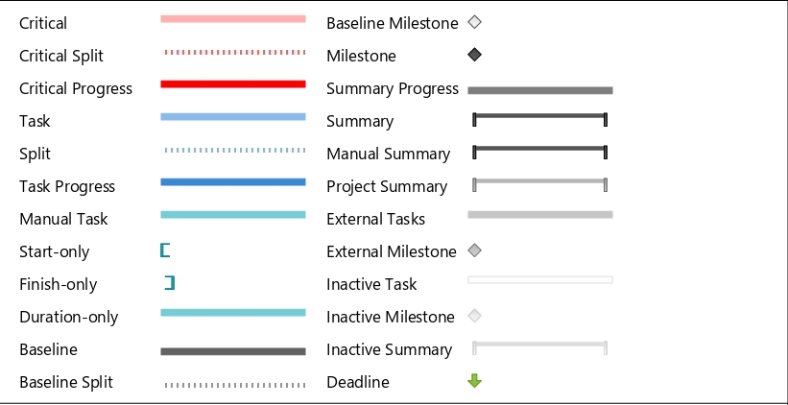
Schedule
Legend
Critical Path

Slide 11
Staffing Plan
Position | Abbreviation | Rate ($/hr) | Total Estimated Hours | Major Tasks
Senior Engineer | SENG | $200 | 90 | Approving final design, oversee testing, higher level management
Project Manager | PM | $160 | 121 | Schedule and resource management, more involvement in beam design
Engineer in Training | EIT | $90 | 247 | Preliminary research, structural analysis, project deliverable work
Lab Technician | LBT | $50 | 69 | Concrete mix testing, big beam testing
Drafter | DRF | $60 | 85 | Creating shop drawings

Slide 12
Cost of Engineering Services
1.0 Personnel | Classification | Hours | Rate, $/hr | Total Cost
 | SENG | 90 | $200.00 | $18,000.00
 | PM | 121 | $160.00 | $19,360.00
 | EIT | 247 | $90.00 | $22,230.00
 | LBT | 69 | $50.00 | $3,450.00
 | DRF | 85 | $60.00 | $5,100.00
 | Total Personnel | 612 |  | $68,140.00
2.0 Travel |  |  |  | $509.00
3.0 Supplies |  |  |  | $400.00
4.0 Subcontract |  |  |  | $21,151.00
5.0 TOTAL |  |  |  | $90,200.00

Slide 13
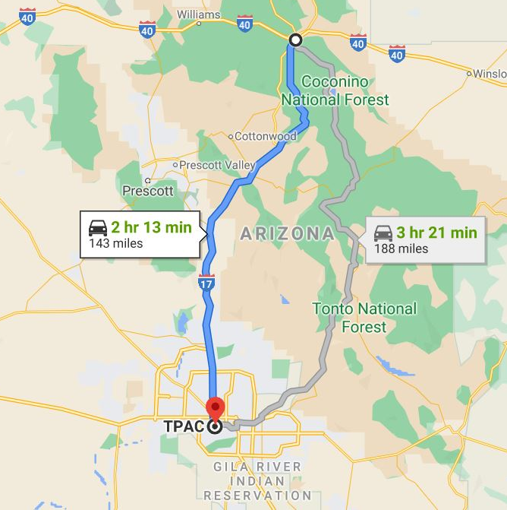
Travel Breakdown
Driving Mileage
Number of Vehicles | Total Mileage | Reimbursement per Mile (cents) | Total Reimbursement (cents) | Total Reimbursement (dollars)
2 | 572 | 44.5 | 50908 | $509.08
Supplies Breakdown
NAU Lab Rental
Number of Days | Cost per Day | Total Supply Cost
4 | $100.00 | $400.00
Figure 7: Directions from NAU to Tpac [6]

Slide 14
Subcontract Breakdown
Concrete Test Cylinders
Number of Test Cylinders | Cost per Cylinder | Total Cylinder Cost
43 | $5.00 | $215.00
Prestressed/Precast Concrete Beam
Cost of Concrete | Cost of Steel | Total Beam Cost
$200.00 | $450.00 | $650.00
Labor
Number of Workers | Rate, $/hr | Total Labor Cost
10 | $50.00 | $20,000.00
Delivery of Beam to Flagstaff
Total Mileage | Cost per Mile (Dollars) | Total Shipping Cost
286 | $1.00 | $286.00

Slide 15
References
[1] PCI Big Beam Competition Rules, PCI, 2021.
[2] "Prestressed Concrete," 2 September 2020. [Online]. Available: https://www.designingbuildings.co.uk/wiki/Prestressed_concrete. [Accessed 3 November 2020].
[3] ORDINARY CONCRETE CYLINDER – COMPRESSION TEST, London: Expedition Workshed, 2020.
[4] H. Murad, S. Rzeszut, C. Chapman, and D. Perera, “Shop Drawings,” PCI Big Beam Competition 2019-2020, 04-May-2020. [Online]. Available: https://www.ceias.nau.edu/capstone/projects/CENE/2020/PCIBigBean/Project%20information.html. [Accessed: 09-Nov-2020].
[5] R. Crouch, S. Gergal, F. Rojo and B. Wagoner, "PCI Big Beam Competition 2017-2018," Northern Arizona University, Flagstaff, 2018.
[6] “Directions to Tpac from College of Engineering, Informatics, and Applied Sciences - NAU,” Google Maps, 2020.

